Slide 1

Chapter 2 Slides
Introduction to Java
PowerPoint Presentation
created by:
Mr. John L. M. Schram
and Mr. Leon Schram

Slide 2
Section 2.3
A Visit to the
United Nations

Slide 3

A Visit to the United Nations
At the UN some 200 different languages are spoken.
To illustrate the complex task of allowing all of the world leaders to communicate, the example on the next slide simply shows 12 world leaders.

Slide 4
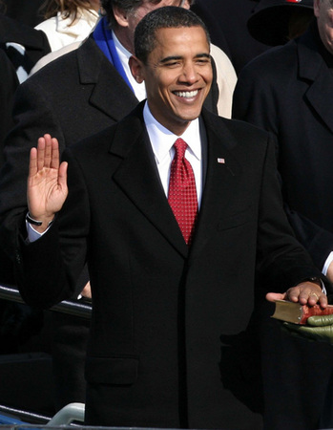
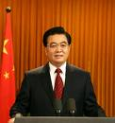

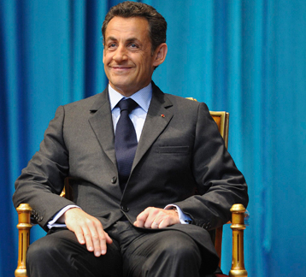

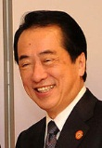

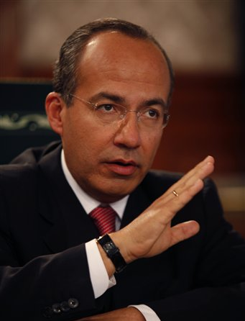
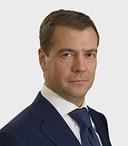
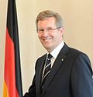
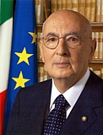
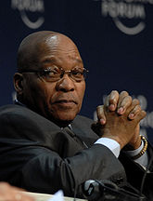
Prime
Minister
Gordon
Brown
English
Great
Britain
President
Hu Jintao
China
Chinese
Prime Minister
Mark Rutte
Netherlands
Dutch
President Sarkozy
France
French
President Obama
United States
English
For example:
President Obama would need different translators for Dutch, German, Spanish, French, Italian, Russian, Chinese, Japanese, and Afrikaans.
Prime Minister
Naoto Kan
Japan
Japanesse
President Juan Manuel Santos
Colombia
Spanish
President
Dmitry Medvedev
Russia
Russian
President
Christian Wulff
Germany
German
President
Jacob Zuma
South Africa
Afrikaans
President
Napolitano
Italy
Italian
President Calderon
Mexico
Spanish

Slide 5
Prime
Minister
Gordon
Brown
English
Great
Britain
President
Hu Jintao
China
Chinese
Prime Minister
Mark Rutte
Netherlands
Dutch
President Sarkozy
France
French
President Obama
United States
English
With 200 world leaders, if we want to be able to translate instantly
(as in one single step) from any language to any other language about 20,000 translators would be needed.
Prime Minister
Naoto Kan
Japan
Japanesse
President Juan Manuel Santos
Colombia
Spanish
President
Dmitry Medvedev
Russia
Russian
President
Christian Wulff
Germany
German
President
Jacob Zuma
South Africa
Afrikaans
President
Napolitano
Italy
Italian
President Calderon
Mexico
Spanish

Slide 6
Prime
Minister
Gordon
Brown
English
Great
Britain
President
Hu Jintao
China
Chinese
Prime Minister
Mark Rutte
Netherlands
Dutch
President Sarkozy
France
French
President Obama
United States
English
The solution is not to try to translate in one step, but to allow the translation to occur in two steps.
Every world leader brings one translator that knows their native language, and English.
Prime Minister
Naoto Kan
Japan
Japanesse
President Juan Manuel Santos
Colombia
Spanish
President
Dmitry Medvedev
Russia
Russian
President
Christian Wulff
Germany
German
President
Jacob Zuma
South Africa
Afrikaans
President
Napolitano
Italy
Italian
President Calderon
Mexico
Spanish

Slide 7
Prime
Minister
Gordon
Brown
English
Great
Britain
President
Hu Jintao
China
Chinese
Prime Minister
Mark Rutte
Netherlands
Dutch
President Sarkozy
France
French
President Obama
United States
English
Translator
Translator
Translator
Translator
ENGLISH
Translator
Translator
Translator
Prime Minister
Naoto Kan
Japan
Japanesse
President Juan Manuel Santos
Colombia
Spanish
Translator
Translator
Translator
Translator
Translator
President
Dmitry Medvedev
Russia
Russian
President
Christian Wulff
Germany
German
President
Jacob Zuma
South Africa
Afrikaans
President
Napolitano
Italy
Italian
President Calderon
Mexico
Spanish

Slide 8
Section 2.4
Java
Bytecode

Slide 9
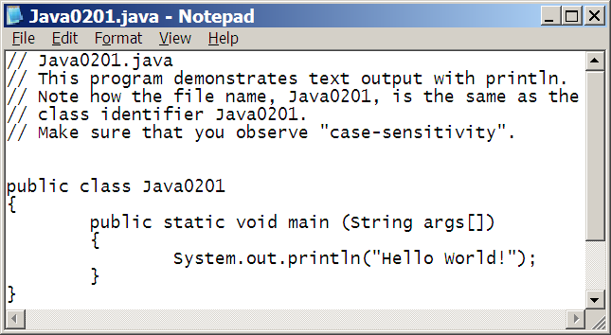
What does the UN have to do with Java?
Compiler
BYTECODE
MAC Interpreter
Compaq Interpreter
HP Interpreter

Slide 10
Platform Independence
A programming language is considered platform independent or portable if program source code created on one type of computer platform can execute on another computer platform without any difficulty.

Slide 11
Bytecode
Bytecode is a low level-level code file that cannot execute as a regular machine code file.
Bytecode is understood, and executed, by a Java interpreter, called a Java Virtual Machine (JVM).

Slide 12
Java Uses a Compiler AND an Interpreter
Java uses a compiler to translate the program source code created by the programmer into bytecode.
Java then continues and uses an interpreter to translate the bytecode into executable machine code line by line.

Slide 13
Section 2.5
Applications
and Applets

Slide 14
Applet or Application?
A Java program designed to operate inside a web page is called an applet.
A Java program designed to operate in a stand-alone environment is called an application.

Slide 15
Section 2.6
Using
Java Software

Slide 16
The Basic Java Tools
A text editor to write Java program source code.
A compiler to translate source code into bytecode.
An interpreter to translate and execute bytecode.

Slide 17
3 Steps of a Java Program
1. Write the Java source in some text editor.
The source code file must end with .java
2. Translate the source code file with a Java
compiler into an intermediate bytecode file
that will end with .class
3. Execute the bytecode file with a Java Virtual
Machine (JVM) program, which is an interpreter.
Note: All three of these steps can be done with a
text editor and the command prompt or an Integrated Development Environment (IDE), like JCreator.

Slide 18
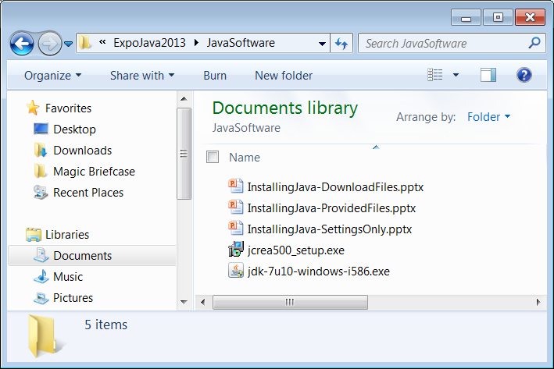
Instructions on how to install the Java software are provided in 3 different PowerPoint presentations.
If necessary, your teacher will tell you which to use. Remember that JCreator will not function unless the JDK (Java Development Kit) is installed first.

Slide 19
Compiling & Executing
Java Programs

Slide 20
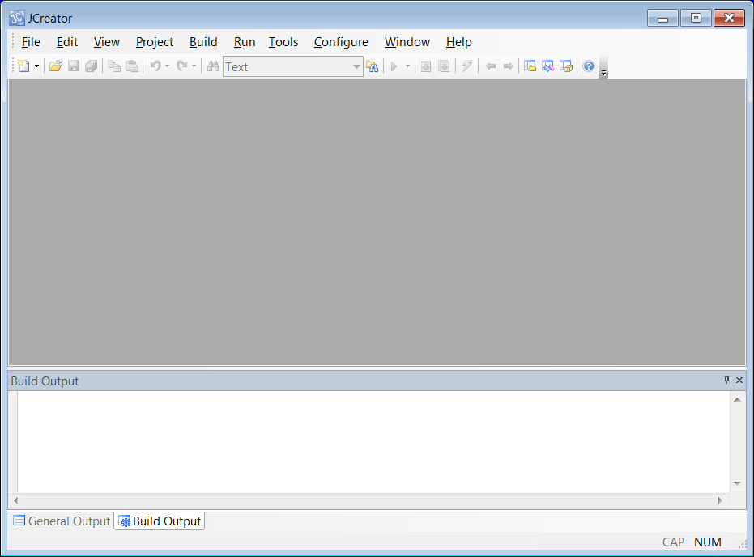
Load JCreator.

Slide 21
Click on File and select Open.

Slide 22
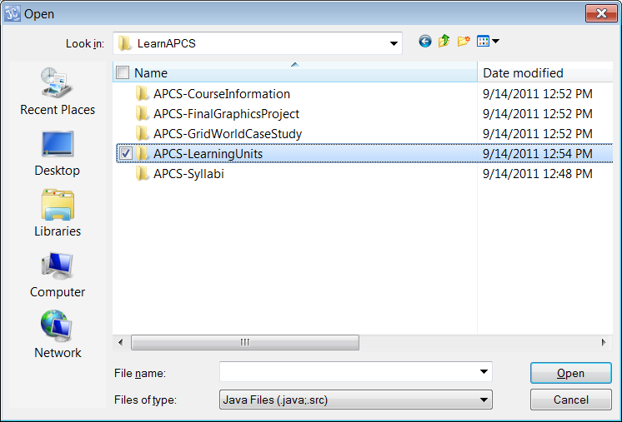

Slide 23
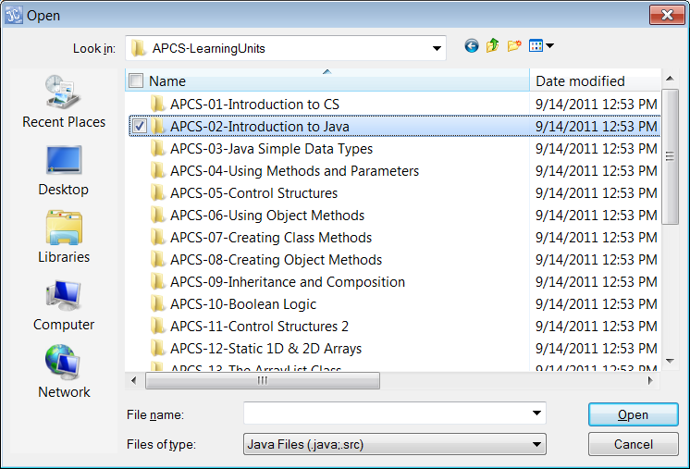

Slide 24
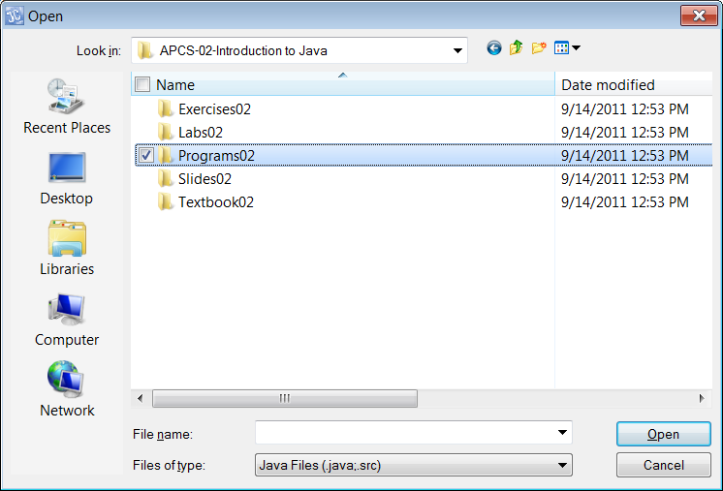

Slide 25
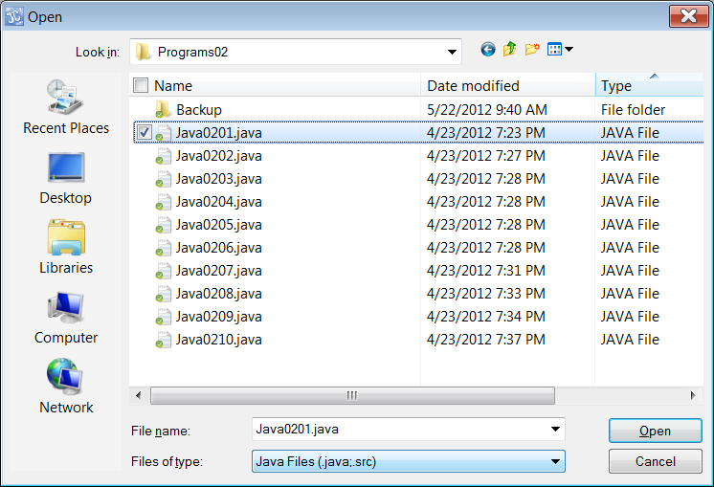

Slide 26
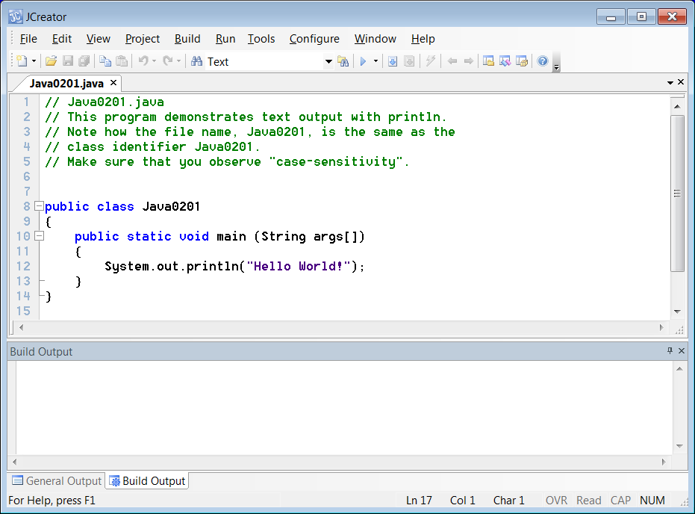

Slide 27
First click
this to compile.

Slide 28
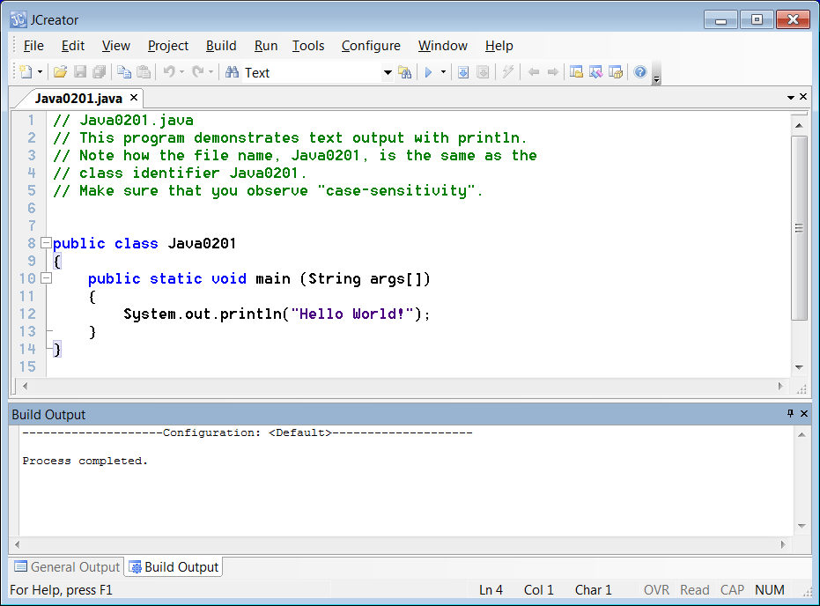
The words "Process completed."
indicate the compiling process is finished,
but not necessarily successful.
The compiling is successful if there are no errors listed.

Slide 29
Next click
this to execute.

Slide 30
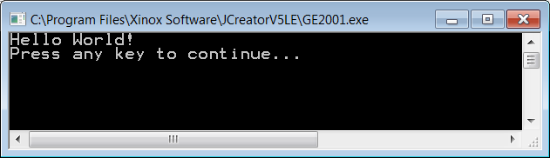
Then the output will display.

Slide 31
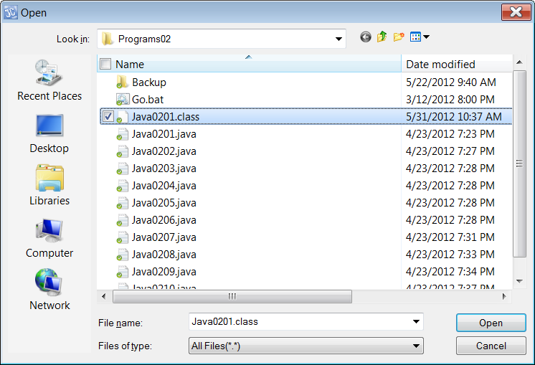
NOTE:
After the program
has compiled,
a new .class file
has been created.
You will not see
this file unless
you change
“Files of type:”
to “All Files”.

Slide 32
We now wish to focus on
the actual Java programs.
A GUI display like this
might look nice, but the
programs are too hard to read.
A different format will be
used to view the programs.

Slide 33
Section 2.7
Text Output
With print
& println

Slide 34
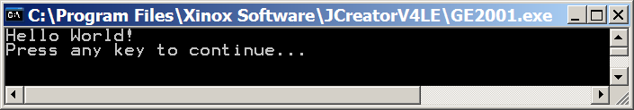
// Java0201.java
// This program demonstrates text output with println.
// Note how the file name, Java0201, is the same as the
// class identifier Java0201.
// Make sure that you observe "case-sensitivity".
public class Java0201
{
public static void main (String args[])
{
System.out.println("Hello World!");
}
}

Slide 35
Remember to Re-Compile!
After any change to a program, no matter how small, you must recompile the program before testing the execution!

Slide 36
Java Keywords and Program Statements
A Java keyword is a word that has a special meaning in the program or performs a special function.
One or more keywords combine to make a program statement.
Keywords in Java are case-sensitive.
This means that System is a Java keyword, which is not the same as system.

Slide 37
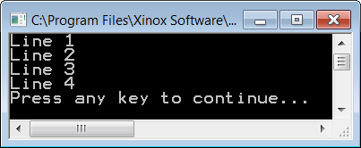
// Java0202.java
// This program demonstrates how to display four lines of text
// using the <println> keyword.
public class Java0202
{
public static void main(String args[])
{
System.out.println("Line 1");
System.out.println("Line 2");
System.out.println("Line 3");
System.out.println("Line 4");
}
}

Slide 38
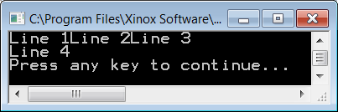
// Java0203.java
// This program demonstrates the difference between
// <print> and <println>. The <println> command adds a
// "line feed" after the output display.
public class Java0203
{
public static void main(String args[])
{
System.out.print("Line 1");
System.out.print("Line 2");
System.out.println("Line 3");
System.out.println("Line 4");
}
}

Slide 39
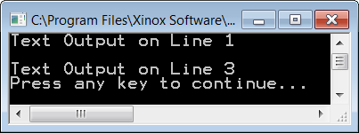
// Java0204.java
// This program shows how to skip a line between statements.
// Using <println> with empty parentheses will generate
// a carriage-return/line-feed.
public class Java0204
{
public static void main (String args[])
{
System.out.println("Text Output on Line 1");
System.out.println();
System.out.println("Text Output on Line 3");
}
}

Slide 40
System.out.print & System.out.println
Both keywords println and print generate an output display of characters contained between double quotes.
Both println and print follow keywords System.out.
println("Java is an island in Indonesia.") will display:
Java is an island in Indonesia.
print("Java is an island in Indonesia.") will also display:
Java is an island in Indonesia.
The keyword println generates display followed by a carriage-return/linefeed (CRLF).
The keyword print generates display without a crlf.
The statement System.out.println(); generates a crlf, meaning skip a line, without any other display.

Slide 41
Section 2.8
Program
Compile Errors

Slide 42
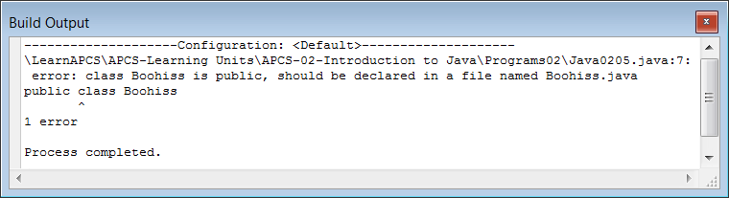
// Java0205.java
// This program demonstrates that the file name of a program
// and the public class name must be identical.
// This program will not compile.
public class Boohiss
{
public static void main (String args[])
{
System.out.println("The bytecode file name");
System.out.println("will be the same as the");
System.out.println("public class identifier.");
}
}

Slide 43
File Names and Class Names
The external file name of your program needs to be identical to the public class name inside your program, minus the java extension.
For example:
If you use public class Howdy in your program then you need to save the program with Howdy.java.

Slide 44
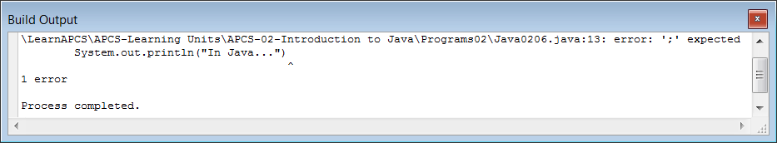
// Java0206.java
// This program has an intentional mistake.
// The output window indicates an error and the program does not execute.
// Many error messages provide important clues to help fix the problem.
public class Java0206
{
public static void main (String args[])
{
System.out.println("In English...");
System.out.println("Every sentence ends with a period (.)");
System.out.println("In Java...")
System.out.println("Every statement ends with a semicolon (;)");
}
}
Here is the error.
A semicolon (;) is missing.

Slide 45
01
02
03
04
05
06
07
08
09
10
11
12
13
14
15
16
17
18
19
20
21
// Java0206.java
// This program has an intentional mistake.
// The output window indicates an error and the program does not execute.
// Many error messages provide important clues to help fix the problem.
public class Java0206
{
public static void main (String args[])
{
System.out.println("In English...");
System.out.println("Every sentence ends with a period (.)");
System.out.println("In Java...")
System.out.println("Every statement ends with a semicolon (;)");
}
}
NOTE: The error message indicates the
line where the error was found.

Slide 46
Section 2.9
Program
Comments

Slide 47
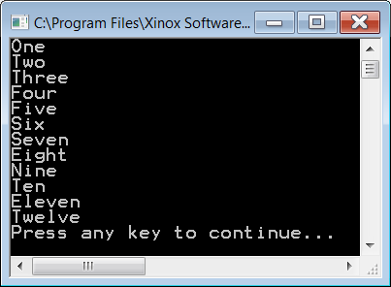
// Java0207.java
// This program displays several number words.
// The focus now is on program comments.
// Program comments aid in "program documentation" and make your program more readable.
// Every line that begins with a "double slash" is considered a "comment" by the Java compiler.
// The Java compiler ignores all comments. They are not compiled. They are not executed.
// If a line begins with a double slash, it is simply ignored by the compiler.
// That is precisely what is happening with the first 12 lines of this program.
// Note below that a comment can also be placed in the middle of the program.
// They can even be placed right after a program statement on the same line.
// Note: The word "Thirteen" is not displayed because it has been "commented-out"
// possibly by someone suffering from Triskaidekaphobia (the fear of the number 13).
public class Java0207
{
public static void main (String args[])
{
System.out.println("One");
System.out.println("Two");
System.out.println("Three");
System.out.println("Four");
System.out.println("Five");
System.out.println("Six"); // half a dozen
System.out.println("Seven");
System.out.println("Eight");
System.out.println("Nine");
System.out.println("Ten");
System.out.println("Eleven");
System.out.println("Twelve"); // one dozen
// System.out.println("Thirteen"); // one baker's dozen
}
}

Slide 48
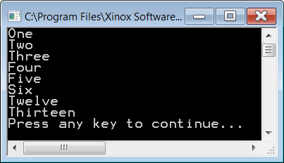
// Java0208.java
/* This program is very similar to the previous program, but the output will be different.
Instead of displaying all number words from "One" through "Thirteen",
it will only display some of them. There are actually 2 kinds of comments in Java.
"Single-Line Comments" are the type you saw in the last program.
They begin with a double slash. Java also has "Multi-Line Comments".
To create a multi-line comment, you begin with a slash and an asterisk.
You conclude a multi-line comment with an asterisk followed by a slash.
This can be very useful in program development.
This time the output will not show the words "Seven" through "Eleven" because they
have been "commented-out" with a multi-line comment. */
public class Java0208
{
public static void main (String args[])
{
System.out.println("One");
System.out.println("Two");
System.out.println("Three");
System.out.println("Four");
System.out.println("Five");
System.out.println("Six"); // half a dozen
/* System.out.println("Seven");
System.out.println("Eight");
System.out.println("Nine");
System.out.println("Ten");
System.out.println("Eleven");
*/ System.out.println("Twelve"); // one dozen
System.out.println("Thirteen"); // one baker's dozen
}
}

Slide 49
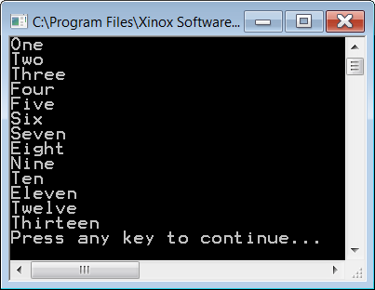
/*********************************
* Java Program 0209 *
* Numbers from 1-13 *
* By: John Schram *
* 3/22/12 *
* *
* This program is similar to *
* the previous two and shows *
* that a comment can be used *
* to create a heading. *
*********************************/
public class Java0209
{
public static void main (String args[])
{
System.out.println("One");
System.out.println("Two");
System.out.println("Three");
System.out.println("Four");
System.out.println("Five");
System.out.println("Six"); // half a dozen
System.out.println("Seven");
System.out.println("Eight");
System.out.println("Nine");
System.out.println("Ten");
System.out.println("Eleven");
System.out.println("Twelve"); // one dozen
System.out.println("Thirteen"); // one baker's dozen
}
}

Slide 50
/*********************************
* Java Program 0209 *
* Numbers from 1-13 *
* By: John Schram *
* 3/22/12 *
* *
* This program is similar to *
* the previous two and shows *
* that a comment can be used *
* to create a heading. *
*********************************/
public class Java0209
{
public static void main (String args[])
{
System.out.println("One");
System.out.println("Two");
System.out.println("Three");
System.out.println("Four");
System.out.println("Five");
System.out.println("Six"); // half a dozen
System.out.println("Seven");
System.out.println("Eight");
System.out.println("Nine");
System.out.println("Ten");
System.out.println("Eleven");
System.out.println("Twelve"); // one dozen
System.out.println("Thirteen"); // one baker's dozen
}
}
TRY THIS!
Remove this slash (/) and see what happens to the program.
Remember to put the slash back.

Slide 51
2 Different Types of Comments
// This is a single-line comment.
System.out.println("Hello!"); // So is this.
/* This is
a multi-line
comment. */
/*****************
* So is this. *
*****************/

Slide 52
Section 2.10
Escape
Sequences

Slide 53
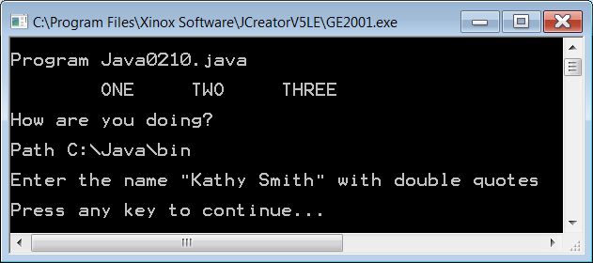
// Java0210.java
// This program demonstrates escape sequences in Java
public class Java0210
{
public static void main (String args[])
{
// \n performs a carriage-return and a line-feed
System.out.println("\nProgram Java0210.java\n");
// \t performs a horizontal tab
System.out.println("\tONE\tTWO\tTHREE\n");
// \r performs only a carriage-return without a line-feed
System.out.print("Hello John\r");
System.out.println("How are you doing?\n");
// \\ displays a single backslash
System.out.println("Path C:\\Java\\bin\n");
// \" displays double quotes
System.out.println("Enter the name \"Kathy Smith\" with double quotes\n");
}
}
Hello John is covered up with
How are you doing?

Slide 54
Section 2.11
The AP Java
Subset

Slide 55
The AP Java Subset
The College Board works together with Educational Testing Service to create the AP Computer Science Examination.
In an effort to create a standardized test for all students, the College Board and ETS have created an AP Java Subset.
The AP Java Subset created by the Test Development Committee of the College Board does not dictate what should be taught in an AP Computer Science course. The AP Java Subset indicates what will be tested.

Slide 56
Section 2.12
The Responsible Use
of Computers

Slide 57

Protect Your Computer From the Environment
Computers and computer information are vulnerable.
Computers can be physically damaged.
RAM is temporary, save often!
Disk, CDs and even hard drives can go bad.
Back up your stuff!
Blackouts and Power Surges
are major problems.
Backup Batteries and
Surge Protectors are useful.

Slide 58
Protect Your Computer From Viruses
A virus is a special program that has these two qualities:
The ability to duplicate itself
to spread to other systems.
The payload it carries, which is a program
that will do some type harm to the computer.

Slide 59
Protect Your Computer From Improper Access
Don't leave your computer unattended and
logged in.
Information can easily be copied or erased
from an unattended computer.
Unattended laptops are easily stolen.
Label and guard your stuff!

Slide 60
The Ethical Use of Computer Software
Copying copyrighted software is illegal.
Companies have been sued and people have been arrested for not taking this seriously.

Slide 61
Hacking
Some confused people think that if you hack into a network, it is fine as long as you don't steal any money or damage any information.
Just attempting to hack into a computer
or network is a misdemeanor.
If you actually succeed at getting in,
you have already committed a felony.
Yes, high school students
have been prosecuted for this!
WRONG!

Slide 62
Vandalism
Physical computer vandalism is bad, but typically not a problem in high school.
You also need to make sure you do not alter ANY settings on the computer or install ANY software unless directed to do so by your teacher.
Altering settings can prevent the computer from working properly.
Downloading software has legal issues and can also cause the spread of viruses.

